Slide 1

HOUSING DATA ANALYSIS
Alekhya Reddy Pasarakayala

Slide 2
ABOUT DATASET
The Dataset consists of 1057 records with 10 attributes. The names of Dataset are:
Price, Living Area, Garage Space, Bathrooms, Bedrooms, Fireplaces, Pool, Lot Size, Age, Fireplaces (Boolean value)
RESEARCH QUESTIONS:
Is there a significant difference in the average price of the houses based on the age of the building using Anova?
Analysis of age and living area related to the price of the house with a linear regression for price based on age and living are for 95%. Outputs from Descriptive Statistics for House Pricing.
Price of property depends on living area or age or both, is there any significant relation between mean price of property in age or living area groups?
How well does a linear regression model predict the prices of houses based on the number of bedrooms and bathrooms?
Find out the Linear regression analysis for the pool and garage based on price with some graphs?
Identify and analyze ANOVA for columns living area, fireplaces, and lot size

Slide 3
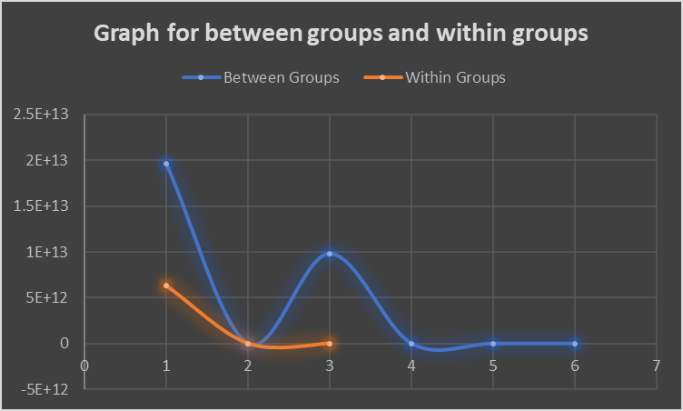
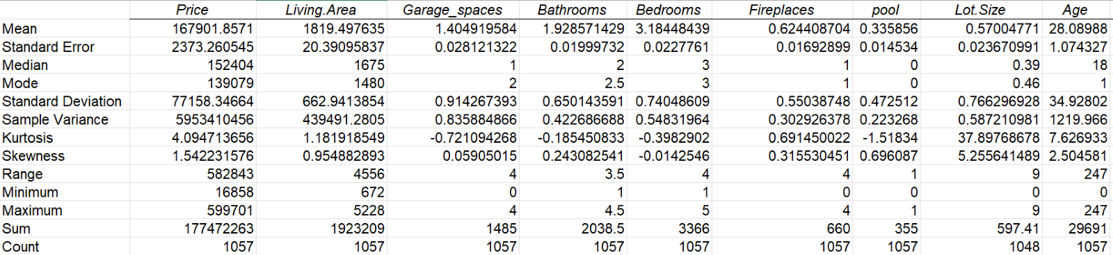
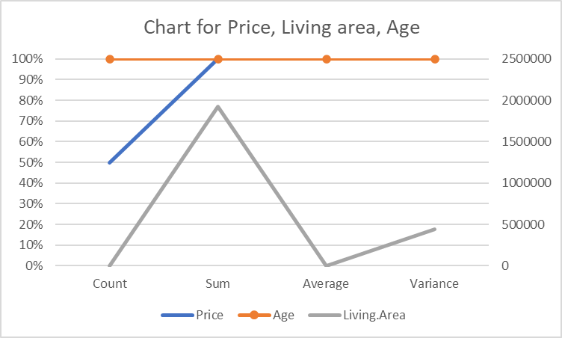
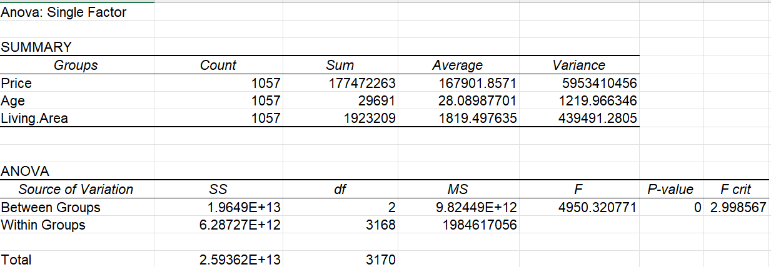
Descriptive Statistics
Anova Graphical Representation:
Anova: Single Factor

Slide 4
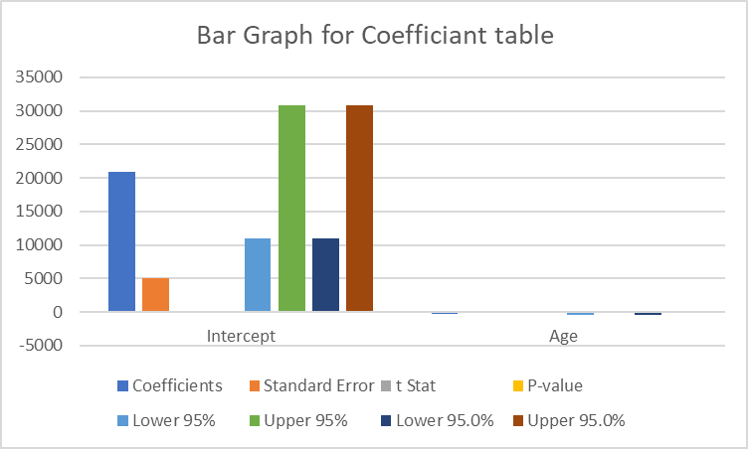
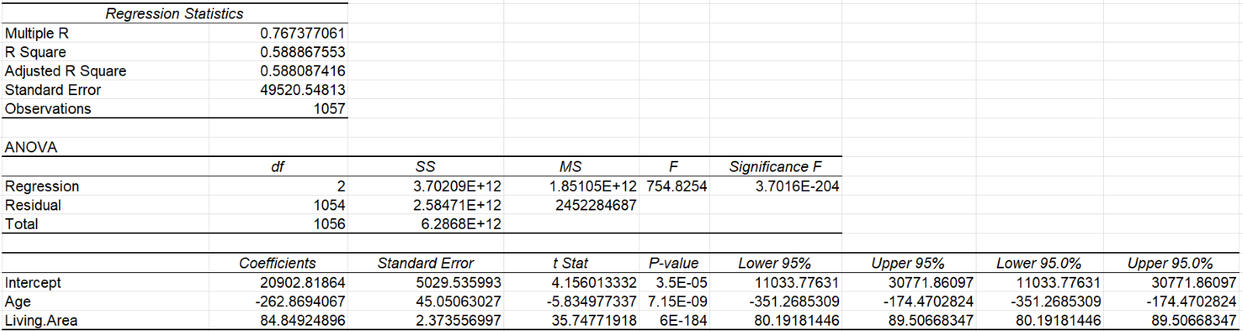
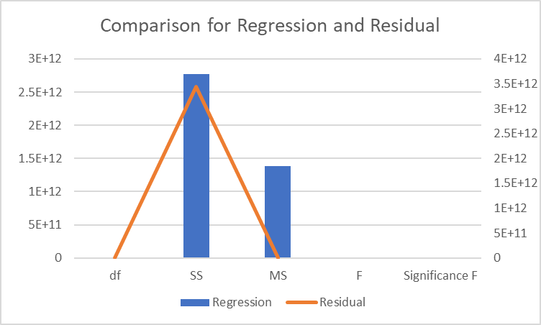
Analysis of age and living area related to the price of the house with a linear regression
From the output we can observe that R-square value is 58.9% and Adjusted R Square value is 58.8% which means that the model is a good fit as the difference between R square and Adjusted R square is negligible.
The Graphical representation shows the comparison between different outputs for Price and Age values.

Slide 5
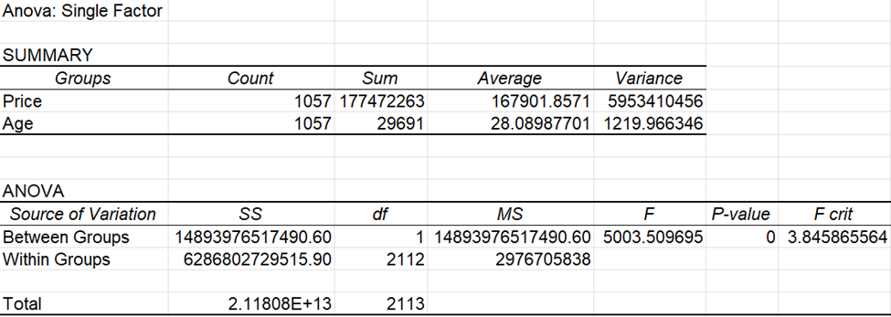
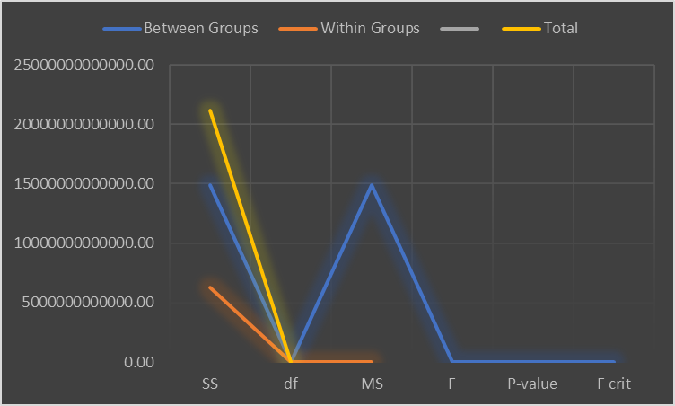
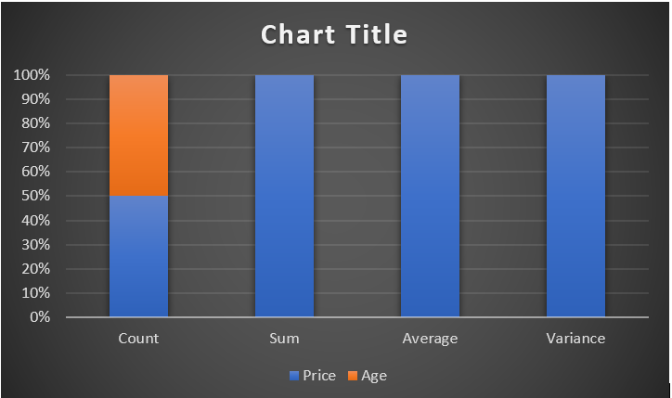
The significant difference in the average price of the houses based on the age of the building using Anova
Anova analysis of the Price and Age of a building found a significant relationship between the two factors, as indicated by a P-value of 0. The graphical representation of between and within groups showed a high level of significance, with the count of each group being equal (50%) and the sum, average and variance representing 100%.

Slide 6
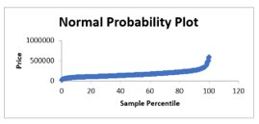
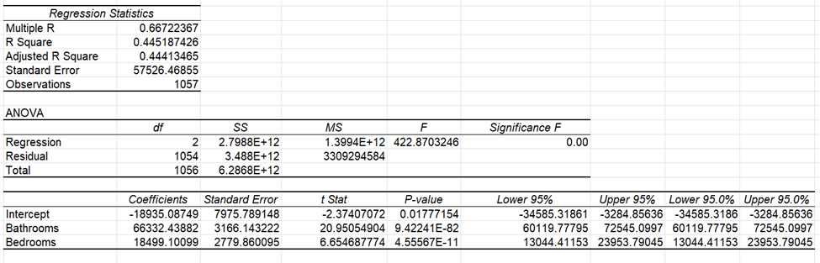
Prediction of the prices of houses based on the number of bedrooms and bathrooms using Linear regression
A linear regression model was used to measure the effect of number of bedrooms and bathrooms on the price of a property. The dataset contained 1057 observations and the results showed a strong correlation between the two independent variables and the dependent variable. The R-square value of 44.5% indicated that the model was a good fit. Visualizations such as line fit plots and normal probability plots provided further evidence of the correlation.

Slide 7
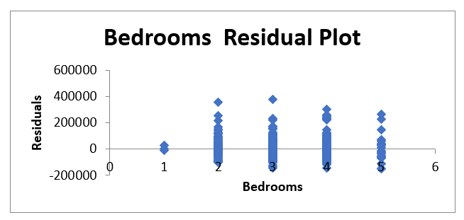
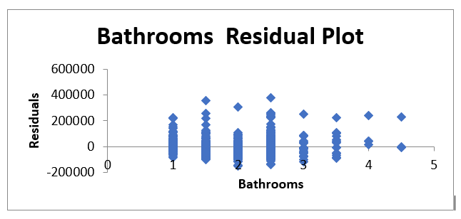
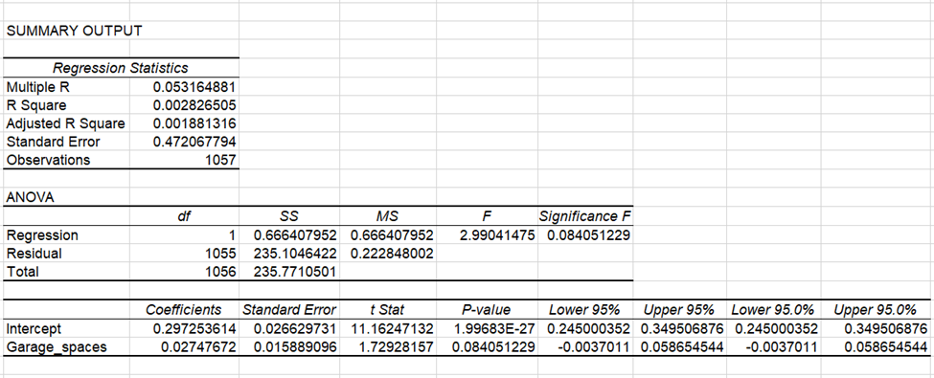
ANALYSIS OF THE POOL AND GARAGE WITH SOME GRAPHS USING LINEAR REGRESSION

Slide 8
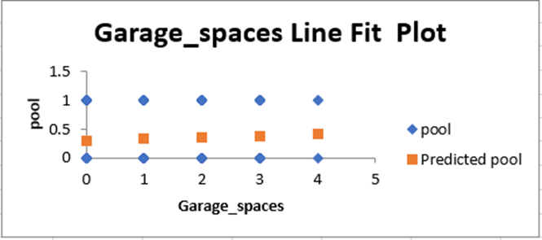
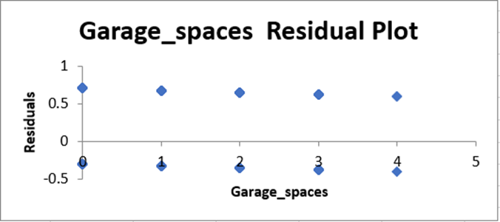
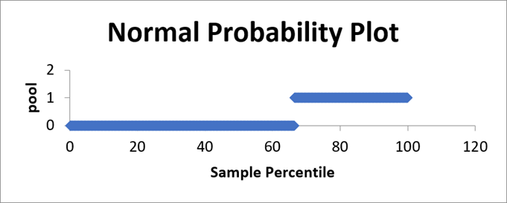
Graphs:

Slide 9
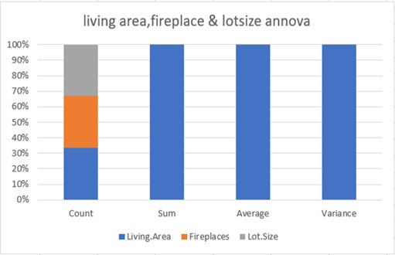
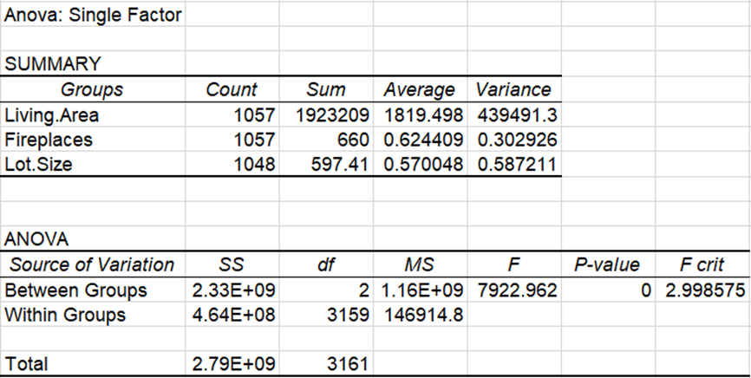
Analysis of Anova on Living area, Fireplaces, and Lot size
we can observe the source of variation of both between groups and within groups with the sum of squares, degrees of freedom, mean square, p-value, and the F and F critic.

Slide 10
Conclusion:
We can say that, from linear regression age and living are depended on price. The output provides the analysis of coefficients, standard error, t stat, p-value, lower 95%, upper 95%, lower 95.0%, and upper 95.0% for both the intercept and garage spaces.
We have proposed different models to check whether there is a significant relation between the different attributes using ANOVA analysis and multiple regression and all our models are considerably significant.
Future scope:
Based on present analysis, we can predict how the house price may vary in next 5-10 years.
We can develop more data visualization tools for a better understanding of future predictions by using regression models and ANOVA.

